Slide 1
Ansible Tower

Slide 2
Contents
Ansible Tower Overview
Tower Licensing, Updates, and Support
Installation
Tower UI login & walk through
Running automations from Tower

Slide 3
Ansible Tower Overview
Tower is a commercial offering that helps teams manage complex multi-tier deployments by adding control, knowledge, and delegation to Ansible-powered environments.
Tower is a graphically-enabled framework accessible via a web interface and a REST API endpoint for Ansible, the open source IT orchestration engine.
Whether sharing operations tasks with your team or integrating with Ansible through the Tower REST API, Tower provides many powerful tools to make your automation life easier.
Tower helps you scale IT automation, manage complex deployments and speed productivity. Centralize and control your IT infrastructure with a visual dashboard, role-based access control, job scheduling, integrated notifications and graphical inventory management.
Tower's REST API and CLI make it easy to embed Ansible Tower into existing tools and processes.

Slide 4
Tower Licensing, Updates, and Support
“Ansible Tower” is a proprietary software product provided via an annual subscription entered into between you and Red Hat, Inc.
Red Hat provides 3 different editions of Tower
Enterprise Premium
Enterprise Standard
Self Support ( AWX )
Red Hat offers support for paid Enterprise: Standard and Enterprise: Premium Subscription customers seeking help with the Ansible Tower product
Self Support Tower: The AWX Project -- AWX for short -- is an open source community project, sponsored by Red Hat, that enables users to better control their Ansible project use in IT environments.
AWX is designed to be a frequently released, fast-moving project where all new development happens. Ansible Tower is produced by taking selected releases of AWX, hardening them for long-term supportability, and making them available to customers as the Ansible Tower offering.

Slide 5
Tower Features comparison
 | FEATURE | SELF Support | STANDARD | PREMIUM
CONTROL | ANSIBLE TOWER DASHBOARD See a summary view of your entire Ansible environment at any time | YES | YES | YES
 | REAL TIME JOB OUTPUT Watch your Ansible Playbook jobs update in real-time | YES | YES | YES
 | REMOTE COMMAND EXECUTION Execute simple Ansible tasks on your inventory on an as-needed basis | YES | YES | YES
 | JOB SCHEDULING Schedule Playbooks to run at a specific time or to repeat | YES | YES | YES
 | PULL FROM SOURCE CONTROL Pull and sync your Playbooks and Inventories from Git, SVN, or Mercurial | YES | YES | YES
 | VISUAL INVENTORY MANAGEMENT View your inventory and sync with Amazon, GCE, Rackspace, Azure, VMware, OpenStack, Red Hat Satellite and CloudForms, or your own custom source | YES | YES | YES
 | RUN-TIME JOB PROMPTING Provide credentials, inventory, limits, tags, and more at job launch | YES | YES | YES
 | BUILT-IN NOTIFICATIONS Get Playbook run status automatically via Slack, HipChat, email, custom webhooks and more | YES | YES | YES
 | WORKFLOWS Build multi-Playbook workflows right in Ansible Tower without having to create a new Playbook | NO | YES | YES

Slide 6
KNOWLEDGE | ROLE-BASED ACCESS CONTROL Easily control who can run what tasks on what inventory | YES | YES | YES
 | ANSIBLE TOWER DASHBOARD See a summary view of your entire Ansible environment at any time | YES | YES | YES
 | CREDENTIAL SECURITY Securely encrypt secrets and delegate tasks without exposing them | YES | YES | YES
 | CUSTOM CREDENTIALS Define custom credential types to be used with inventory and playbooks | YES | YES | YES
 | INTEGRATION WITH NETWORK ACCOUNTS Pull users and teams from Google Apps and GitHub | YES | YES | YES
 | INTEGRATION WITH ENTERPRISE ACCOUNTS Pull users and teams from your LDAP or Active Directory server. Integrate with your existing SAML 2.0 and RADIUS authentication | NO | YES | YES
 | AUDIT TRAIL Activity streams on every page show who did what - and when | NO | YES | YES
 | MULTI-TENANCY Use multiple organizations with full privilege separation | NO | YES | YES
 | LOGGING AND ANALYTICS INTEGRATION Automatically export System Tracking and Ansible Tower Job run output to an endpoint of your choosing such as Splunk, ElasticSearch, SumoLogic and others | NO | YES | YES

Slide 7
DELEGATION | ROLE-BASED ACCESS CONTROL Easily delegate Inventory, Credentials, or Playbooks to users | YES | YES | YES
 | PUSH-BUTTON JOB RUNS Launch Ansible Playbooks from the web UI and delegate Playbook runs to team members | YES | YES | YES
 | PORTAL MODE Simplified view for delegated users | YES | YES | YES
 | SURVEYS: EASY FORM-BUILDER Quickly build forms to request job variables from Ansible Tower users | NO | YES | YES
SUPPORT | INSTALLATION SUPPORT Get you up and running with Ansible and Ansible Tower | NO | YES | YES
 | ENTERPRISE SUPPORT 8x5 support | NO | YES | YES
 | PREMIUM SUPPORT 24x7 support | NO | NO | YES
 | ELIGIBLE FOR ADDITIONAL SUPPORT ADD-ONS: ANSIBLE ENGINE BUNDLE Support for Ansible executable engine and select core modules and plugins | NO | YES | YES
AND MORE... | FULLY-DOCUMENTED REST API & TOWER-CLI Integrate Ansible Tower into your existing toolset with the fully-documented API and tower-cli API wrapper | YES | YES | YES
 | MAINTENANCE AND UPGRADES Full access to bugfix and upgrade releases | YES | YES | YES
 | SCALE-OUT CLUSTERING Set up Ansible Tower for active/active redundancy and job scale-out | NO | YES | YES

Slide 8
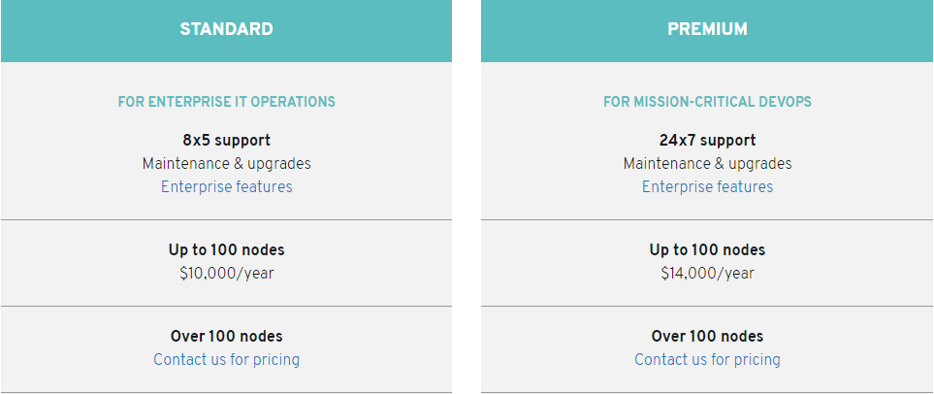
Tower Pricing

Slide 9
Installation
Note:
Ansible Tower must be installed on RHEL 7, CentOS 7, or Ubuntu 14.04 LTS or 16.04 LTS, and requires Ansible Core 2.4.X or later.
Before you can run a deployment, you'll need the following installed in your local environment:
Ansible Requires Version 2.4+
Docker
docker-py Python module
GNU Make
Git Requires Version 1.8.4+
System Requirements
The system that runs the AWX service will need to satisfy the following requirements
At leasts 4GB of memory
At least 2 cpu cores
At least 20GB of space
Running Docker, Openshift, or Kubernetes

Slide 10
Installation Tower Trial – Ubuntu 16.04 LTS
apt-get install software-properties-common
apt-add-repository ppa:ansible/ansible
apt-get update ; apt-get install ansible
apt-get update ; sudo apt-get install postgresql postgresql-contrib
Download Ansible Tower https://www.ansible.com/products/tower/trial
Copy tar file on ubuntu machine under /tmp
Untar using → cd /tmp ; tar xvzf /tmp/ansible-tower-setup-latest.tar.gz
cd /tmp/ansible-tower-setup-<tower_version>
vi inventory & update admin_password, pg_password, rabbitmq_password ; save & exit
run ./setup.sh

Slide 11
Installation AWX- Ubuntu
apt-get update
snap install docker ( ubuntu 18.04 LTS )
apt install python-pip
pip install docker-py
apt install ansible
cd /home ; git clone https://github.com/ansible/awx.git
cd /home/awx/installer
ansible-playbook -i inventory install.yml
In browser hit → http://<ipaddr of awx installed host> Ex: http://192.168.112.144
default UID/PWD → admin/password

Slide 12
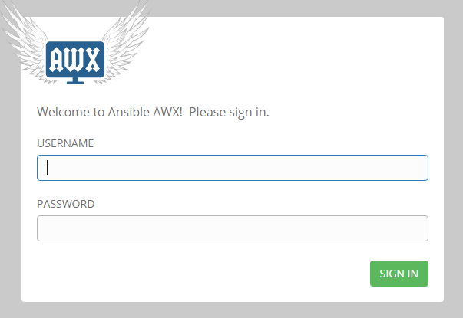
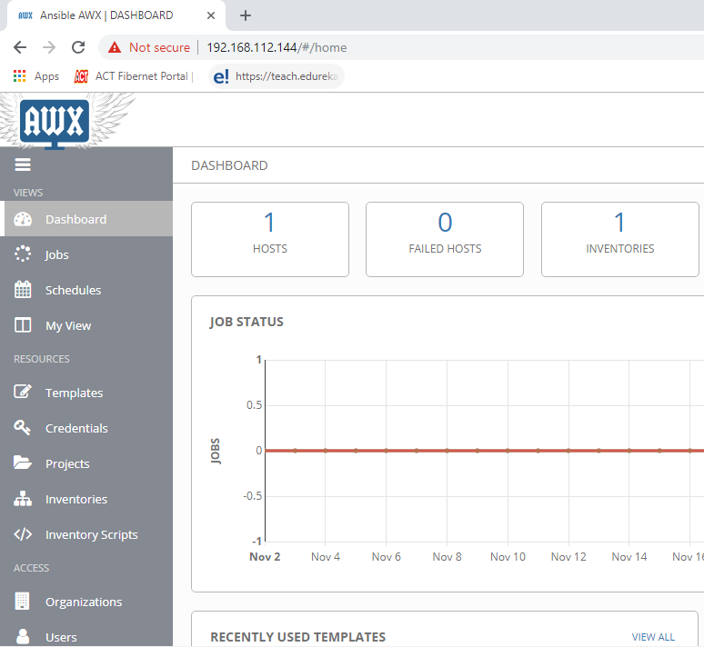
Tower UI login & walk through

Slide 13
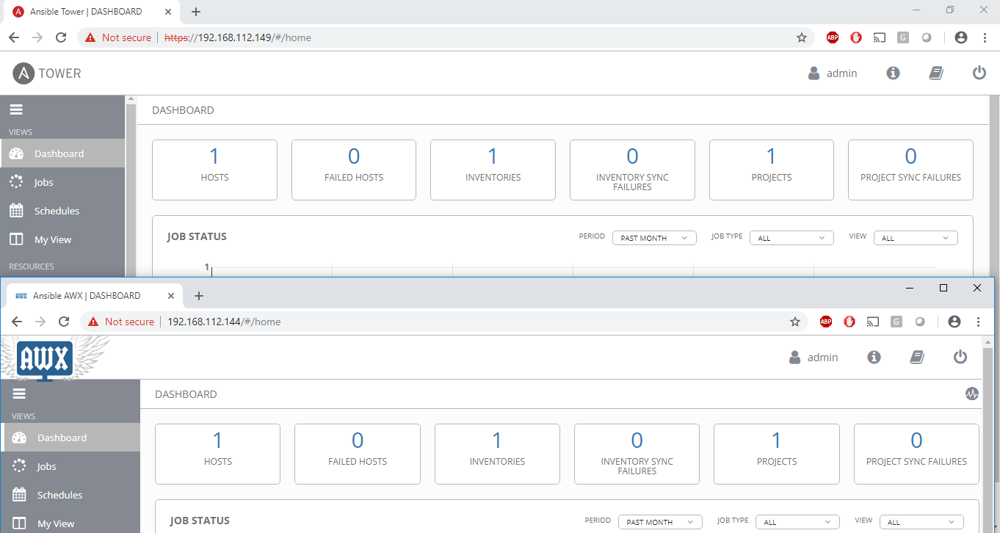

Slide 14
Running automations from Tower
4 Major Steps
create credential
create inventory
create project
create template ( job )
Run the job
Lets Do it !!!

Slide 15
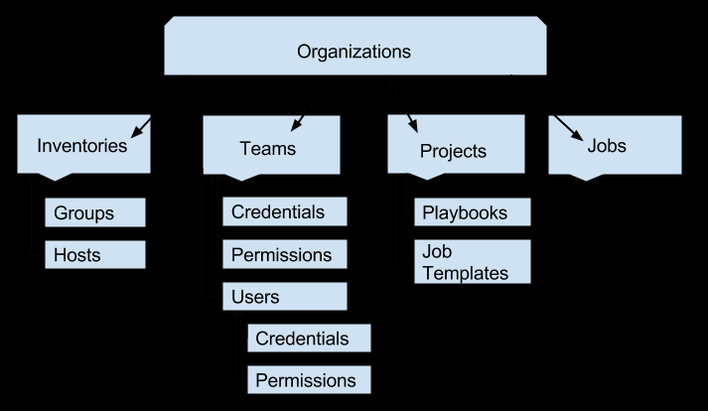
Running automations from Tower
ORGANIZATIONS
An Organization is a logical collection of Users, Teams, Projects, and Inventories, and is the highest level in the Tower object hierarchy.

Slide 16
Running automations from Tower
INVENTORIES
An Inventory is a collection of hosts against which jobs may be launched, the same as an Ansible inventory file. Inventories are divided into groups and these groups contain the actual hosts
TEAMS
A Team is a subdivision of an organization with associated users, projects, credentials, and permissions. Teams provide a means to implement role-based access control schemes and delegate responsibilities across organizations. For instance, permissions may be granted to a whole Team rather than each user on the Team.
PROJECTS
A Project is a logical collection of Ansible playbooks, represented in Tower. You can manage playbooks and playbook directories by either placing them manually under the Project Base Path on your Tower server, or by placing your playbooks into a source code management (SCM) system supported by Tower.
JOBS
A job is an instance of Tower launching an Ansible playbook against an inventory of hosts. The Jobs link displays a list of jobs and their status–shown as completed successfully or failed, or as an active (running) job.

Slide 17
Running automations from Tower
JOB TEMPLATES
A job template is a definition and set of parameters for running an Ansible job. Job templates are useful to execute the same job many times. Job templates also encourage the reuse of Ansible playbook content and collaboration between teams. While the REST API allows for the execution of jobs directly, Tower requires that you first create a job template.
USERS
A User is someone who has access to Tower with associated permissions and credentials. The Users page allows you to manage all Tower users. The User list may be sorted and searched by Username, First Name, or Last Name and click the headers to toggle your sorting preference
CREDENTIALS
Credentials are utilized by Tower for authentication when launching Jobs against machines, synchronizing with inventory sources, and importing project content from a version control system.
NOTIFICATIONS
A Notifier is an instance of a Notification type (Email, Slack, Webhook, etc.) with a name, description, and a defined configuration. A Notification is a manifestation of the notifier for example, when a job fails, a notification is sent using the configuration defined by the Notifier.

Slide 18
Running automations from Tower
MORE INFO

Slide 19
Thank You

